Slide 1
the future of energy development in Colorado
Energizing the World, Bettering People’s Lives
Paul Majors

Slide 2
Forward-looking Statements and
Non-GAAP Measures
This presentation contains certain “forward-looking statements” within the meaning of the federal securities law. Words such as “anticipates,” “believes,” “expects,” “intends,” “will,” “should,” “may,” and similar expressions may be used to identify forward-looking statements. Forward-looking statements are not statements of historical fact and reflect Noble Energy’s current views about future events. They include estimates of oil and natural gas reserves and resources, estimates of future production, assumptions regarding future oil and natural gas pricing, planned drilling activity, future results of operations, projected cash flow and liquidity, business strategy and other plans and objectives for future operations. No assurances can be given that the forward-looking statements contained in this presentation will occur as projected, and actual results may differ materially from those projected. Forward-looking statements are based on current expectations, estimates and assumptions that involve a number of risks and uncertainties that could cause actual results to differ materially from those projected. These risks include, without limitation, the volatility in commodity prices for crude oil and natural gas, the presence or recoverability of estimated reserves, the ability to replace reserves, environmental risks, drilling and operating risks, exploration and development risks, competition, government regulation or other actions, the ability of management to execute its plans to meet its goals and other risks inherent in Noble Energy’s business that are discussed in its most recent Form 10-K and in other reports on file with the Securities and Exchange Commission. These reports are also available from Noble Energy’s offices or website, http://www.nobleenergyinc.com. Forward-looking statements are based on the estimates and opinions of management at the time the statements are made. Noble Energy does not assume any obligation to update forward-looking statements should circumstances or management's estimates or opinions change.
This presentation also contains certain historical and forward-looking non-GAAP measures of financial performance that management believes are good tools for internal use and the investment community in evaluating Noble Energy’s overall financial performance. These non-GAAP measures are broadly used to value and compare companies in the crude oil and natural gas industry. Please also see Noble Energy’s website at http://www.nobleenergyinc.com under “Investors” for reconciliations of the differences between any historical non-GAAP measures used in this presentation and the most directly comparable GAAP financial measures. The GAAP measures most comparable to the forward-looking non-GAAP financial measures are not accessible on a forward-looking basis and reconciling information is not available without unreasonable effort.
The Securities and Exchange Commission requires oil and gas companies, in their filings with the SEC, to disclose proved reserves that a company has demonstrated by actual production or conclusive formation tests to be economically and legally producible under existing economic and operating conditions. The SEC permits the optional disclosure of probable and possible reserves, however, we have not disclosed our probable and possible reserves in our filings with the SEC. We use certain terms in this presentation, such as “net risked resources” and “gross mean resources.” These estimates are by their nature more speculative than estimates of proved, probable and possible reserves and accordingly are subject to substantially greater risk of being actually realized. The SEC guidelines strictly prohibit us from including these estimates in filings with the SEC. Investors are urged to consider closely the disclosures and risk factors in our most recent Form 10-K and in other reports on file with the SEC, available from Noble Energy’s offices or website, http://www.nobleenergyinc.com.
Notes:
2

Slide 3
Agenda
Noble Energy’s Portfolio and Operations
Denver-Julesberg Basin – a transformation for Colorado
  What’s new and what’s at stake
The Basics of Oil and Natural Gas Development
  What are the steps we take to develop Colorado’s energy
Reducing our Environmental Footprint
  Protecting water quality and minimizing water use
  Protecting the air
  Protecting the land and working with our surface owners
EcoNodes and Field Design Are Revolutionizing the DJ Basin
  How EcoNodes and Centralized Processing Facilities Will Improve Performance
  The Wells Ranch Example

Slide 4
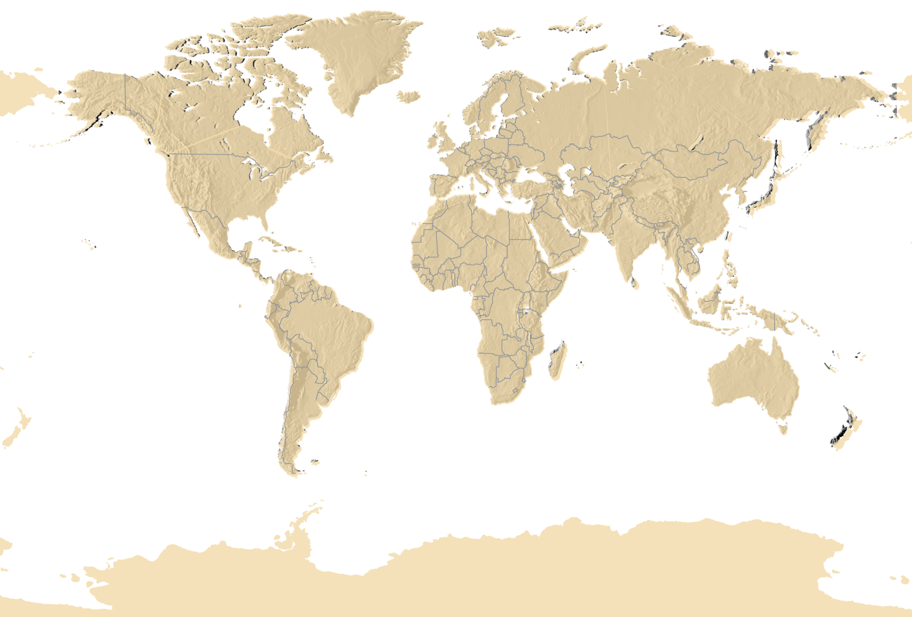
Noble Energy Portfolio
Diversified and technically focused
Core Areas
2013 Est. Prod. of ~275 Mboepd
2013 Capital Spending of $3.9 Billion
Double-digit Growth Over Next Decade
New Ventures
Onshore US
(DJ & Marcellus)
Nevada
Deepwater GOM
Sierra Leone
Israel
Cyprus
Nicaragua
Equatorial Guinea
Cameroon
Falkland Islnds.

Slide 5
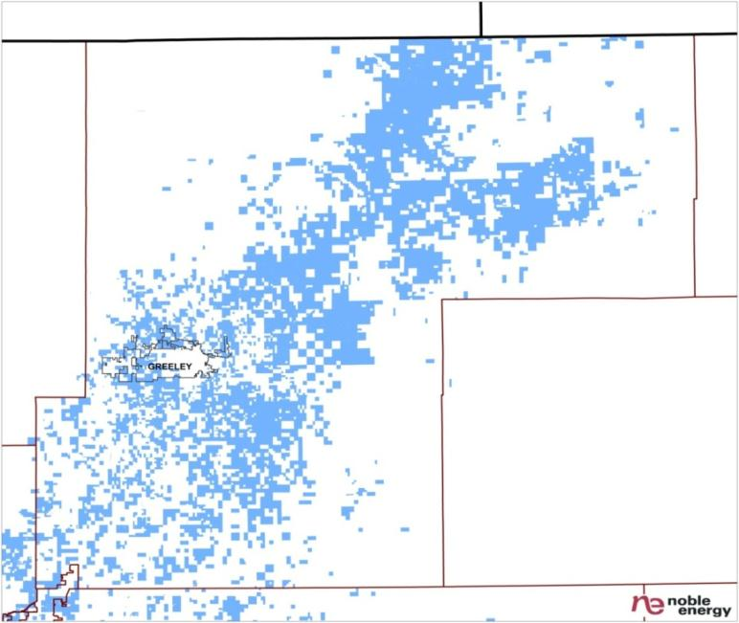

Noble Energy Portfolio and Operations
The DJ Basin
640,000 Net Acres
Accelerating Development
  50% More Wells in 2013 than 2012
Expanding into Northern Colorado
Dramatic Growth in 2013
  Production up 25% to 96 MBoe/d
Investing $1.7 Billion or 45% of Total Capital Program
1000+ Colorado Employees
1500+ Contractors
Wyoming
Nebraska
Northern Colorado
230,000 Net Acres
300 MMBoe NRR
1,750 Locations
290,000 Net Acres
1,400 MMBoe NRR
6,400 locations
Greater Wattenberg
NBL Acreage
120,000 Net Acres
400 MMBoe NRR 1,350 Locations
Gas Window
Oil Window

Slide 6
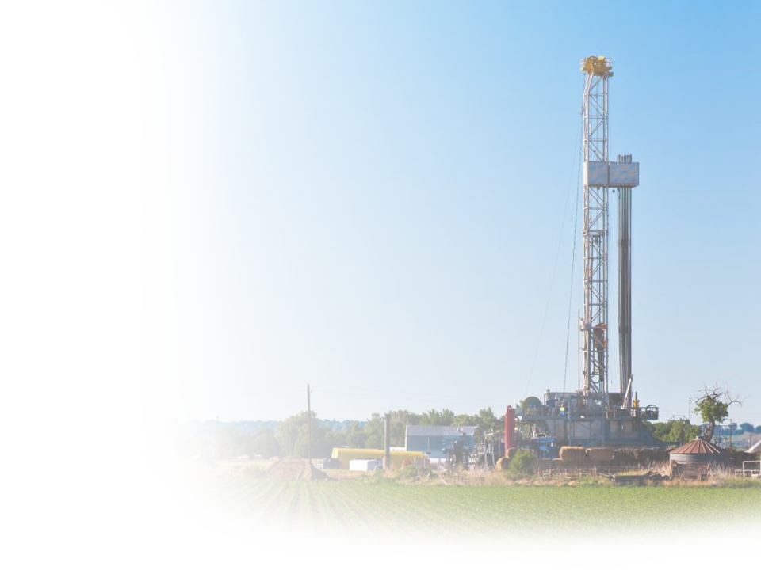
DJ Basin – A Transformation for Colorado
At the intersection of resources and technology
Denver-Julesberg Basin – a premier oil play
  Discovered in 1970
  Technology is unlocking world-class resources
  Combination of horizontal drilling technology with hydraulic fracture stimulation technology is driving up recoverability
Colorado Compares Favorably to Other Plays
  DJ original oil in place (OOIP) now estimated at 74 MMBoe per section
  Bakken OOIP estimates at 10-15 MMBoe per section
  Eagle Ford OOIP estimates at 30-50 MMBoe per section
6.5 BBoe of Technically Recoverable Oil in Niobrara
  2nd Largest Tight Oil Resource in the country, according to “EIA Outlook 2012”
Notes:
Convey excitement about new information to present today. How fast it has evolved, significant increase in scale and scope, rapidly changing for the better
What gets us excited is how we now recognize the DJ Basin as a World Class Oil Resource. Over the years as this basin was just being developed it was very much recognized as a liquids rich natural gas play. This is certainly not the case anymore.
We will update you today on our recoverable resources which have increased from last years numbers by 60% and we will certainly explain got there.
With increased resource comes the challenge of accelerating our program. We will lay out our five year plan to show you how we get to a 20 percent compounded annual growth rate over the next five years.
And to finish up we will certainly layout some of our continued advances in technology and operations to provide you with confidence in our abilities as we consider ourselves the leaders in this play.
6

Slide 7
DJ Basin – A Transformation for Colorado
Technology is Driving the Economic Benefits
Current Oil and Gas Industry Benefits to Colorado*
  $1.6 billion in total annual state and local taxes and royalties (2012)
  111,000 Direct, In-Direct and Induced Jobs supported (2012)
    74,000 upstream; 51,000 direct
  $6.5 billion in annual Colorado supported wages (2012)
  $29.6 billion in economic output for Colorado (2012)
The Potential from Each New DJ Basin horizontal well
  $2,700,000 in average royalties over the life of a well
  1 year ad valorem tax = two hundred $250,000 homes annual property tax
  More than 40% of ad valorem taxes go directly to K-12 education, on average
  Each New Drilling Rig Creates 120 Direct and In-Direct Jobs (annual employee wages = $7.0 – $8.5 million per rig)
* 2012 Assessment of Oil and Gas Industry Economic and Fiscal Contributions in Colorado, CU Leeds School of Business, Business Research Division
Notes:
7
Net Unrisked Resource Data:
2006 International 1285 + N America 940 = 2225 MMBoe (source SCs spreadsheets) * 30% on offshore and 50% onshore (assuming avg Pg) = 0.8 net risked
2011 International 4000 + N America 2659 = 6659 MMBoe (source 10-2011 Drill Worthy spreadsheet) = 3B net risked
Inventory growth factor = 3x
We have purposely not stopped. We built, we are executing, we are growing and adding exploration capabilities, inventory and size.

Slide 8
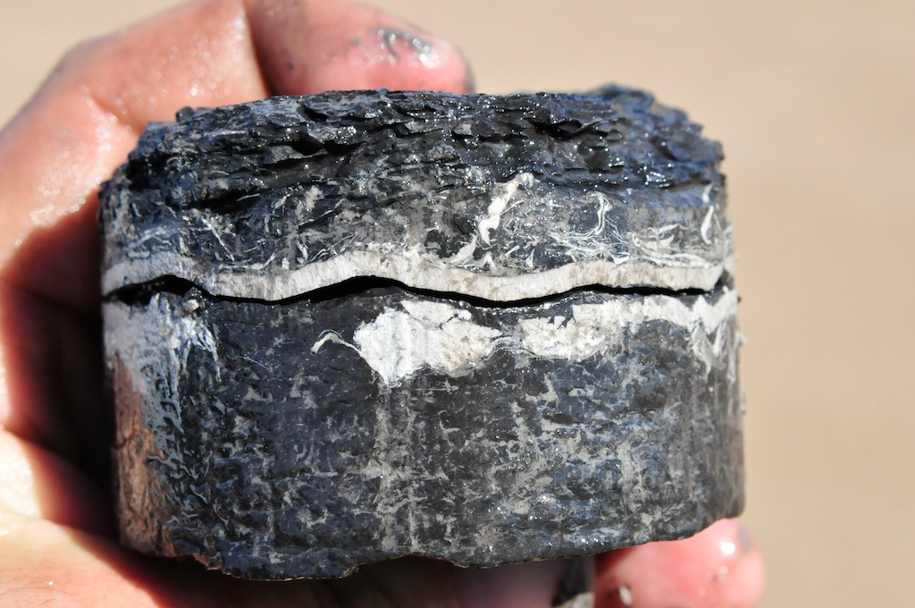
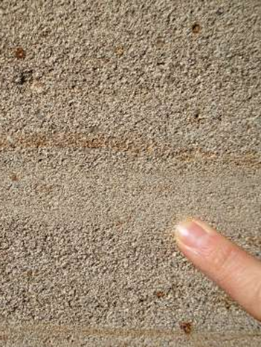
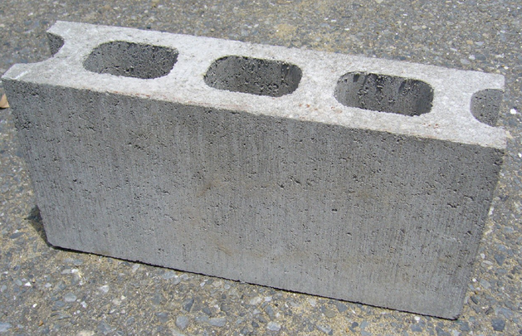
The Basics of Oil and Natural Gas Development
What Does the Rock Look Like?
UNCONVENTIONAL
CONVENTIONAL
Niobrara Fm.
Ultra Low Porosity (2-10%)
Ultra Low Permeability
Fluids will NOT flow naturally
Fluids will only flow if fracture stimulated
(10’s – 100’s bbls/ day when frac’d)
Moderate Porosity (10-20%)
Moderate Permeability
Fluids flow poorly through the rock
(10’s – 100’s bbls/day)
High Porosity (20-40%)
High Permeability
Fluids flow easily through the rock
(100’s – 1000’s bbls/day)

Slide 9
The Basics of Oil and Natural Gas Development
Well Completion Video

Slide 10
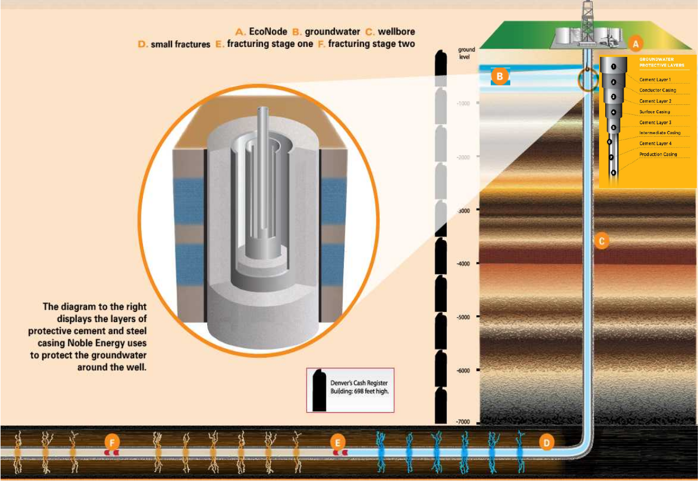
Reducing Our Environmental Footprint
Protecting the Water

Slide 11
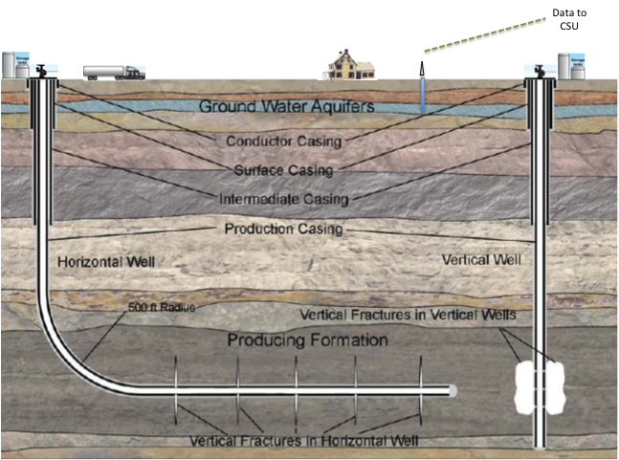
Reducing Our Environmental Footprint
Protecting the Water – Real Time Groundwater Monitoring
Real-time groundwater monitoring system developed and operated by Colorado State University (CSU) Environmental Engineering Dept.
Continuously monitor groundwater quality around unconventional oil & gas development
Data publicly available
Funding from CO Dept. of Natural Resources, Noble Energy, and CSU
2013-14: Initial project of 15 monitoring wells around Noble development area in Weld County, CO
Multiple Casing Layers
Protect Groundwater
Real-time data to CSU
Groundwater
250’ – 500’
1,000’
of Surface Casing
Production Casing
Intermediate Casing down to 7,500’

Slide 12
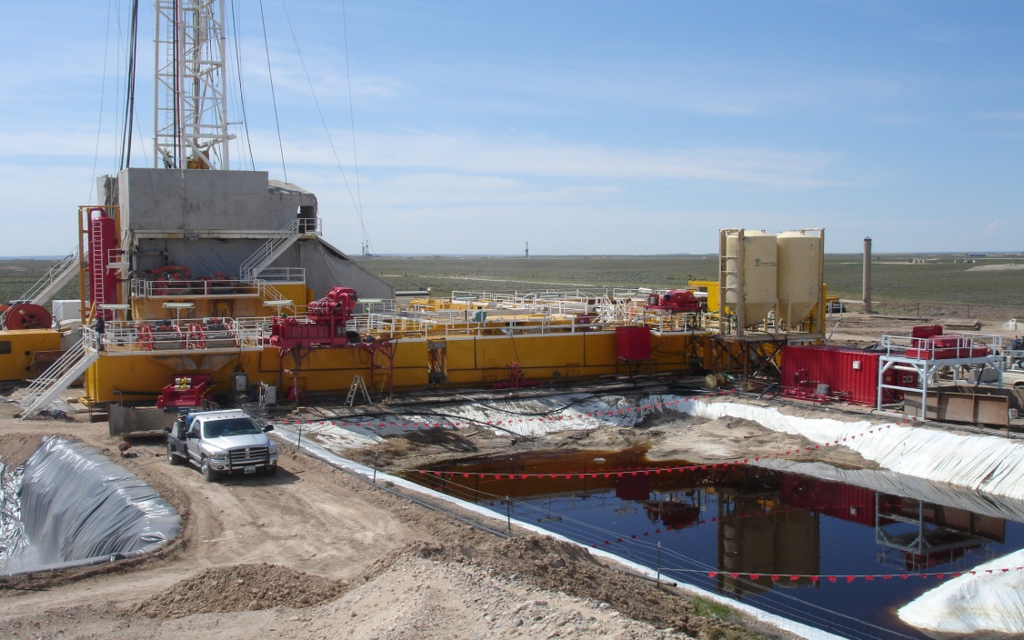
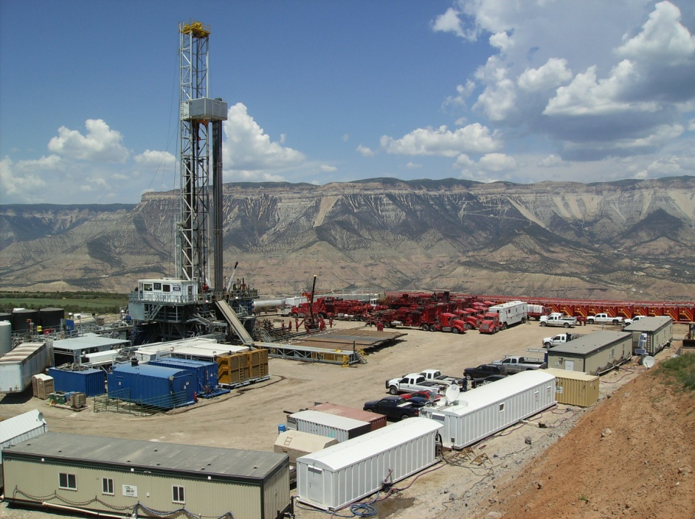
Reducing Our Environmental Footprint
Protecting the Water – Closed Loop Mud Systems
Noble has converted to 100% closed-loop drilling in the DJ Basin
  Greatly reduces water consumption
  Eliminates need for reserve pits
  Reduces risk of groundwater contamination
  Reduces risk of wildlife hazards
  Improves ability to reuse water
  Eliminates need for pit reclamation
Old Way
New Way

Slide 13
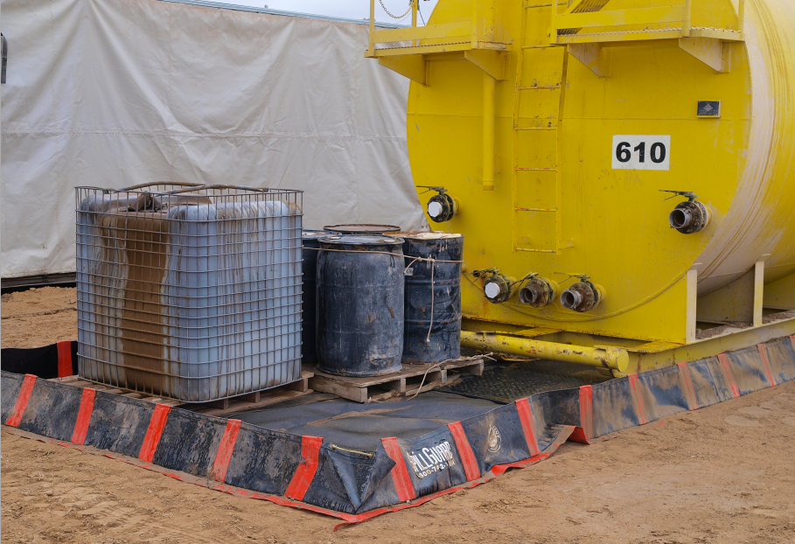
Reducing Our Environmental Footprint
Protecting the Water – Spill Prevention and Containment
Voluntarily set conductor to prevent surface washouts.
Participate in self-reporting of all spills, regardless of size.
Spill containment prevents spills from leaving location.
All spills are cleaned up through fluid removal and soil remediation, if necessary

Slide 14
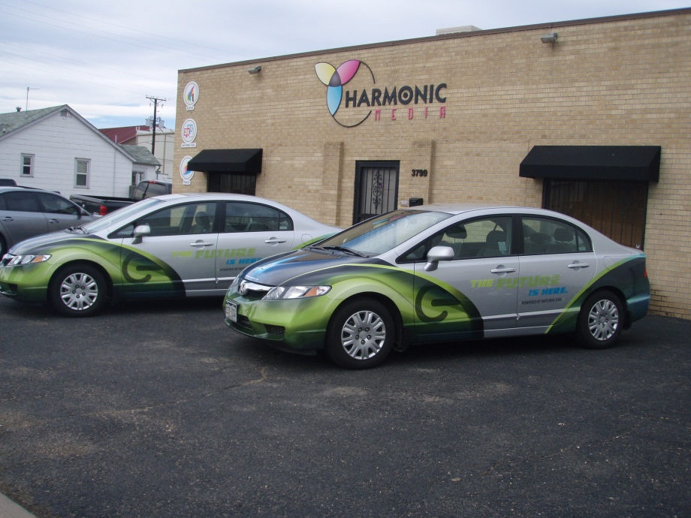

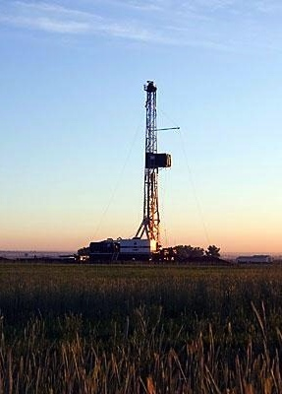
Reducing our Environmental Footprint
Protecting the Air - CNG/LNG Conversion
Noble Energy’s Commitment
  Expanding use of natural gas as fuel in all aspects
  of our operations
Building Colorado’s First LNG Plant
  Building a 100,000 gal/day LNG plant in N. Colorado
  Converting Noble Energy’s fleet to dual fuel (CNG/gasoline)
  Noble Energy’s participation in CNG refueling infrastructure
  Working to Convert All Rigs from Diesel to LNG
Weld County School Bus Initiative
  $5 million / 5 years
  Local natural gas resources as fuel → reduce emissions, clean air for communities
  Seven CNG School Buses donated so far
Using 100,000 gal/day of LNG instead of Diesel
  Equivalent to removing 100,000 cars/year from the roads (NOx)
  CO₂ Reductions Equivalent to 7,961 cars/year

Slide 15
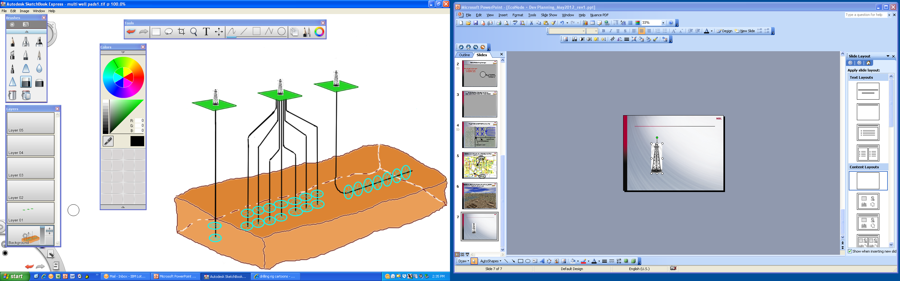
Reducing Our Environmental Footprint
Protecting the Land – Horizontal and Pad Drilling are Reducing Surface Use
Single Well Vertical Pad
  Access multiple pay zones vertically at single point
Multi-Well Directional Pad
  Access multiple pay zones vertically
  Cover broad aerial extent from single surface location
Horizontal Pad
  Equivalent to several vertical wells in one zone only

Slide 16
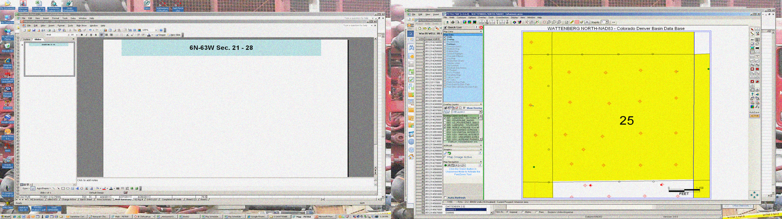


Reducing Our Environmental Footprint
Protecting the Land – EcoNodes Will Further Reduce Surface Use
1
2
3
4
5
6
7
8
9
2
26
E
1
B Chalk
B Marl
C Chalk
EcoNode land use over 2+ Sections
versus
Typical vertical well development land use over 2 Sections
16

Slide 17
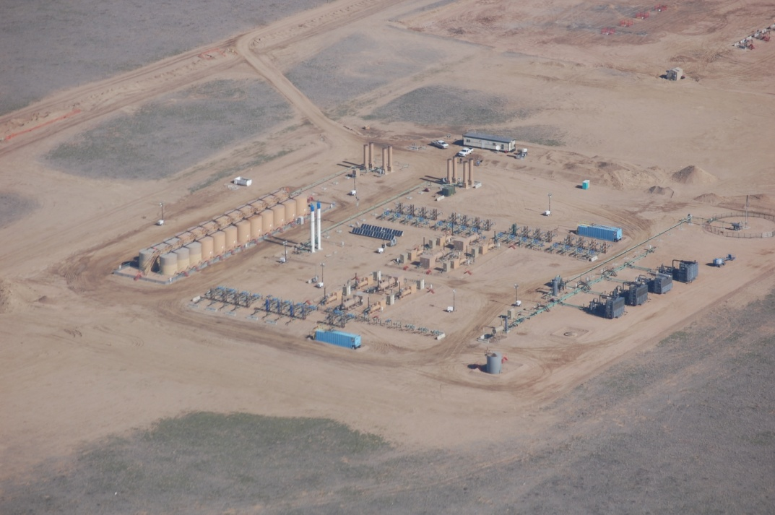
Reducing Our Environmental Footprint
Protecting the Land – EcoNodes Will Further Reduce Our Environmental Footprint
EcoNodes are processing facilities fed by multi- well pads. Generally 16 to 32 wells are processed at one EcoNode, up to 64 possible
  e.g. Wells Ranch AA14/AA16 Econode is producing ~ 5,000 bopd, 2,500 bwpd and 9.2 MMcfpd from 16 horizontal wells
Many EcoNodes will connect to a Central Processing Facility (CPF) via pipelines
EcoNodes are:
  Ecologic
  Economic
  Nodally connected
Benefits
  Reduced overall facility development cost
  Flexibility to accommodate different well densities per section and long laterals
  Reduced land usage
  Increased liquids recovery
  Full flash gas recovery
  Gathering system / CPF – eliminate oil and produced water trucking
  Create water recycling opportunities
  Significant emission reduction

Slide 18
GEN 2

Slide 19
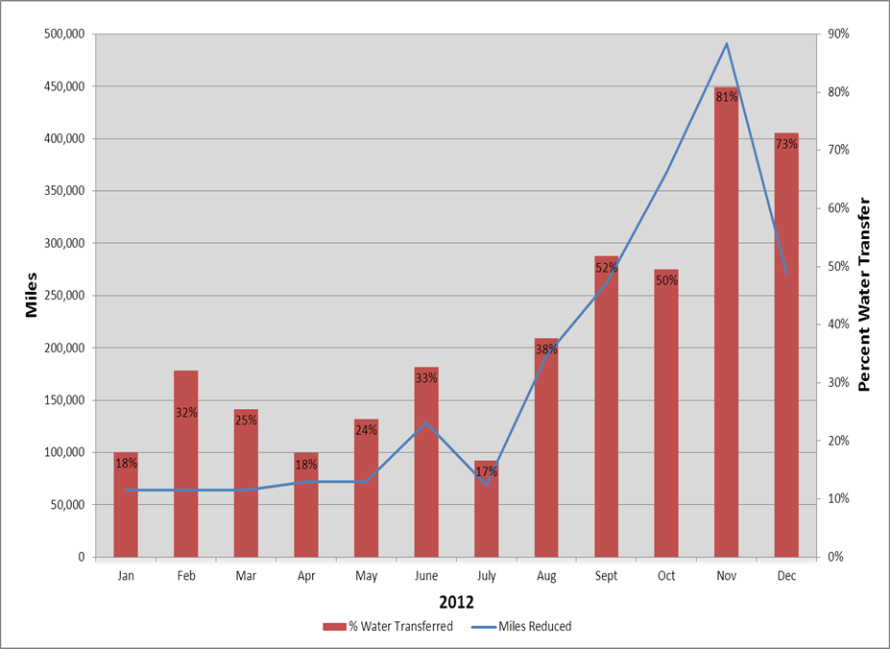
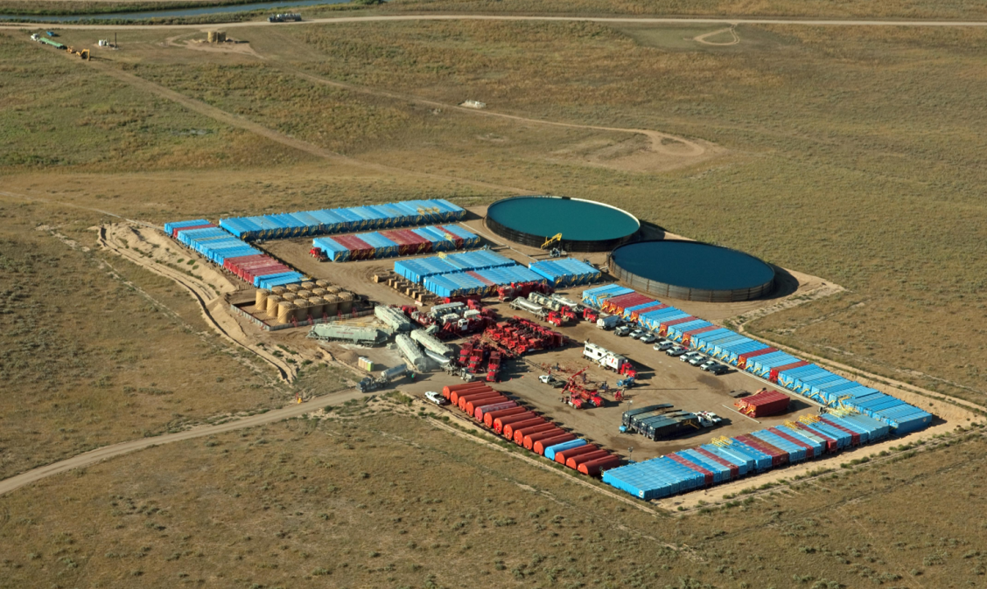
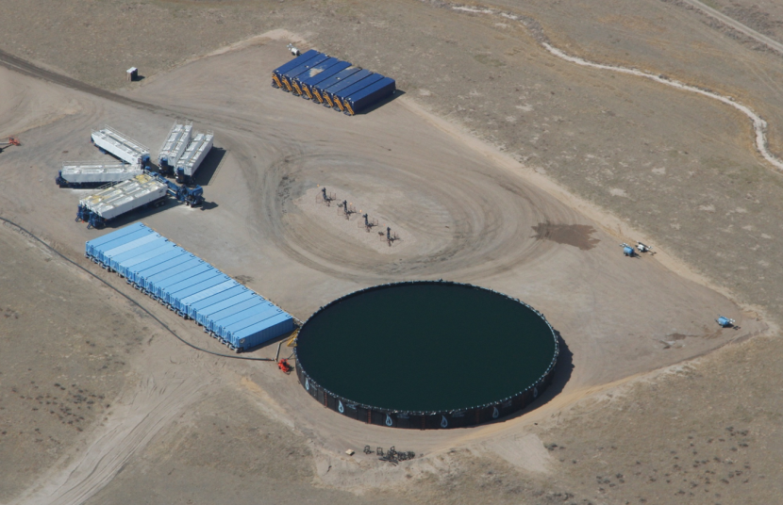
Reducing Our Environmental Footprint
Integrated Design – EcoNodes Improve Water Use and Storage for Completions
EcoNodes promoted the use of large water storage ponds.
  This will reduce tanks on location by >70%
  626,000 tons of CO2 emission will be saved
  Equivalent to 66,000 SUV’s taken off the road for 10 years
Able to complete wells faster and more efficiently with “frac camps” on multi-pads
Then
Now

Slide 20
Reducing Our Environmental Footprint
Additional Benefits of Integrated Design – EcoNodes Improve Air Quality and Truck Traffic
Capture tank flash gas emissions
- 90% VOC emission reduction compared to historic
- No pumper/operator exposure to gas from “strapping” tanks
- 6 MBOE to Estimated Ultimate Recovery of Each Well
Trucks off the road
Implementing new liquids strategy dramatically reduced truck traffic
2013 – 224,000 truck trips or loads of water and oil eliminated
2013-2022 reductions in oil and water truck hauling result in
  Eliminating 626,000 tons of CO2 emissions (equivalent to 118,000 passenger vehicles)
  200 million road miles saved
Land Use
- EcoNodes, CPFs, gathering system, HZ wells = 80%+ land use reduction compared to historic
Water Use
- Ponds and pipes to transfer water, not trucks
- Non-tributary ground water
- Recycled frac/flowback water

Slide 21
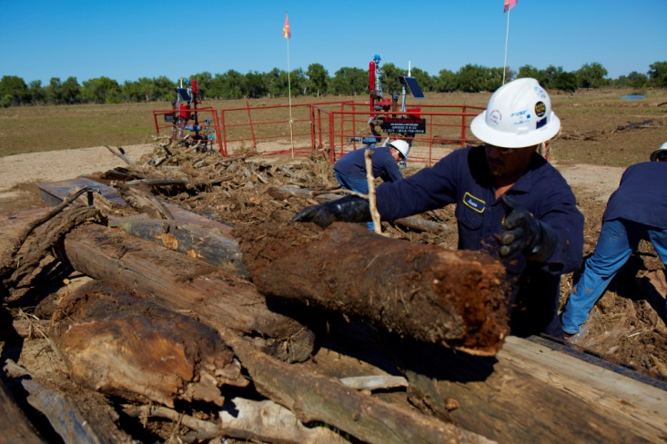


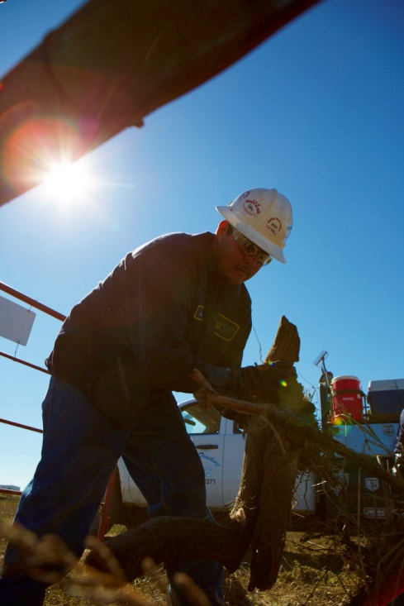


QUESTIONS

Slide 22
Energizing the World,
Bettering People’s Lives®

