Slide 1
US Energy overview
Paul Majors P.E. – Jan 2014

Slide 2
What are we going to talk about today?
Introductions
General overview of energy
What has changed?
Short video
Questions

Slide 3
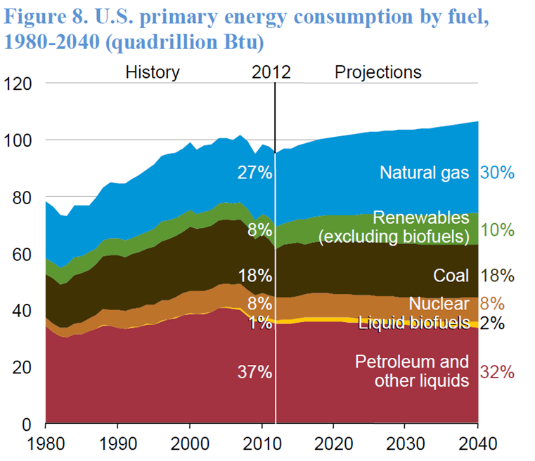
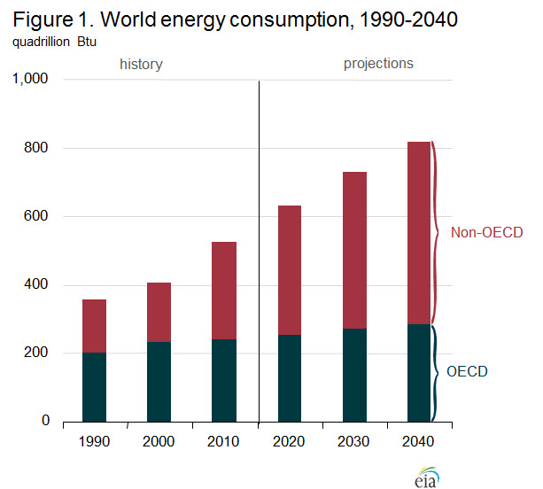
What energy do we use now?
Renewables are on the rise!
But we have a long way to go.
Source – US Energy Information Administration Jan 2014 data

Slide 4
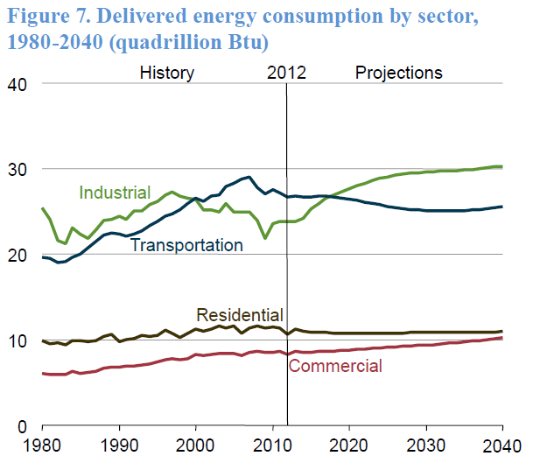
We are doing a good job to reduce our usage for transportation. But overall we will use more.
Data from Jan 2014 EIA report

Slide 5
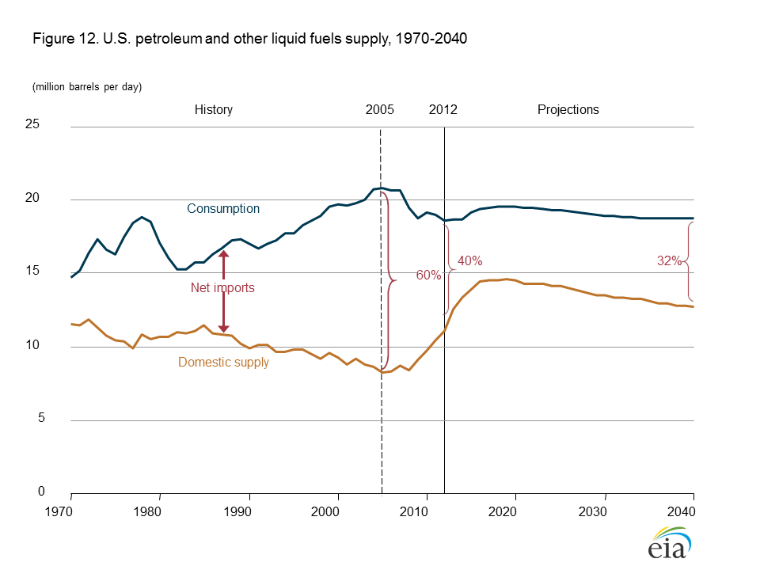
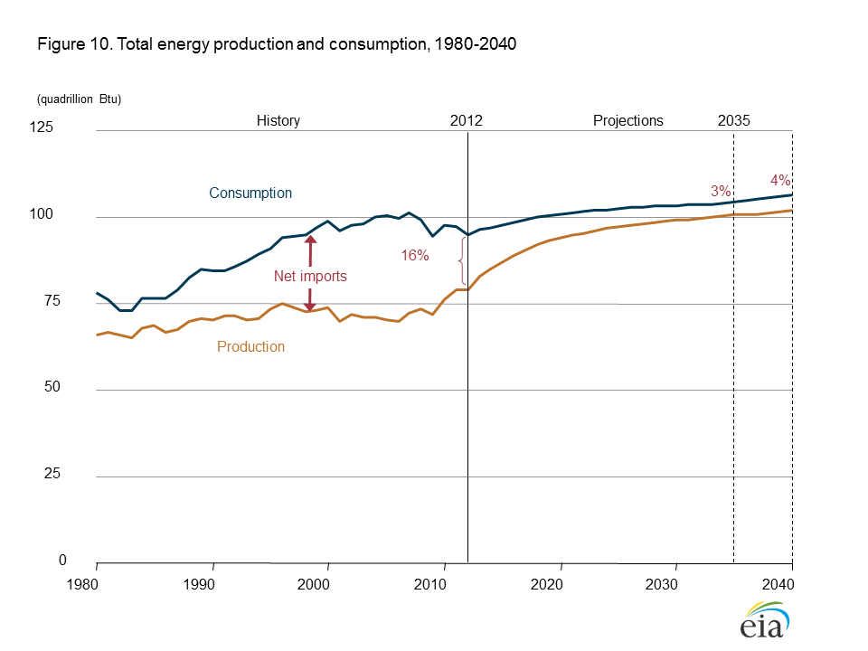
Why is oil and gas still important?
9% of our energy comes from renewables
Most of the renewables are Hydroelectric dams (water power)
2% from Wind and Solar
40% of our oil is imported
Canada is our largest supplier
Venezuela is #2

Slide 6
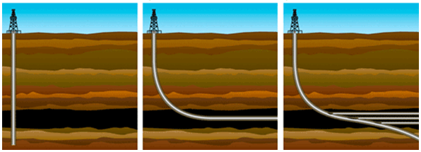
What has changed?
Increase in oil price, but not gas price.
Two old technologies have been put together
Horizontal well drilling – single and multi lateral
Hydraulic fracturing – multi stage

Slide 7
Quick Video – 6.5 min

Slide 8
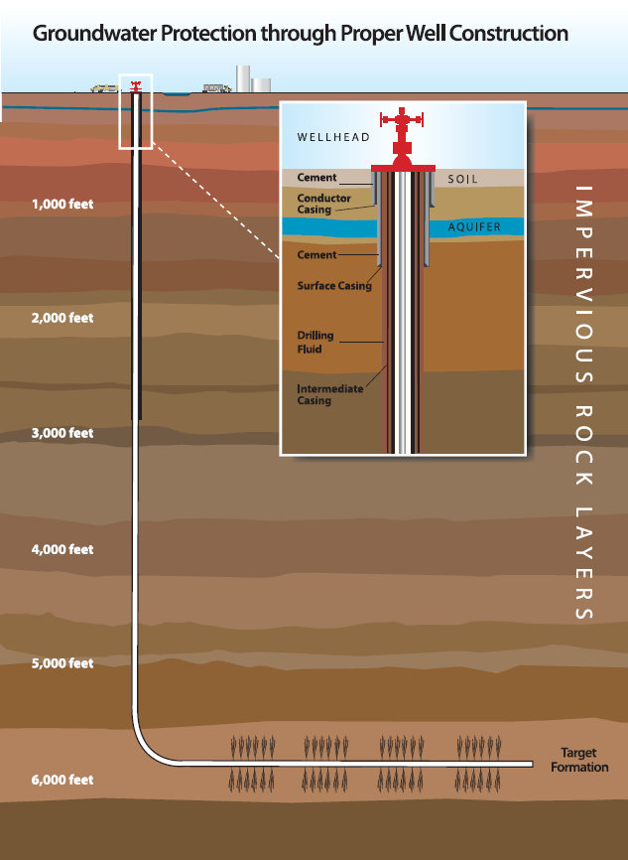
Hydraulic Fracturing
Proven technology – using hydraulic pressure to break-up rock
These rocks are normally over 1 mile (over 5280’) deep
The induced cracks are only hundreds of feet long.
Refined over 60 years.
Over 99.5% water
Been used on over 1,000,000 wells in the US
Over 90 percent of wells in Colorado are hydraulically fractured.
Notes:
Hydraulic fracturing is a proven technology that has been refined over 60 years. It has allowed companies to safely produce natural gas from more than one million U.S. wells, and now it is being used to extract oil and other liquids from shale formations, such as in the Niobrara play. The State of Colorado has been regulating drilling activity since 1951. Every aspect is overseen by the COGCC. Over 90 percent of wells in Colorado are hydraulically fractured. The essential factor with respect to the safety of hydraulic fracturing is proper well construction, including casing and cementing to isolate the production formations being stimulated from shallow groundwater aquifers

Slide 9
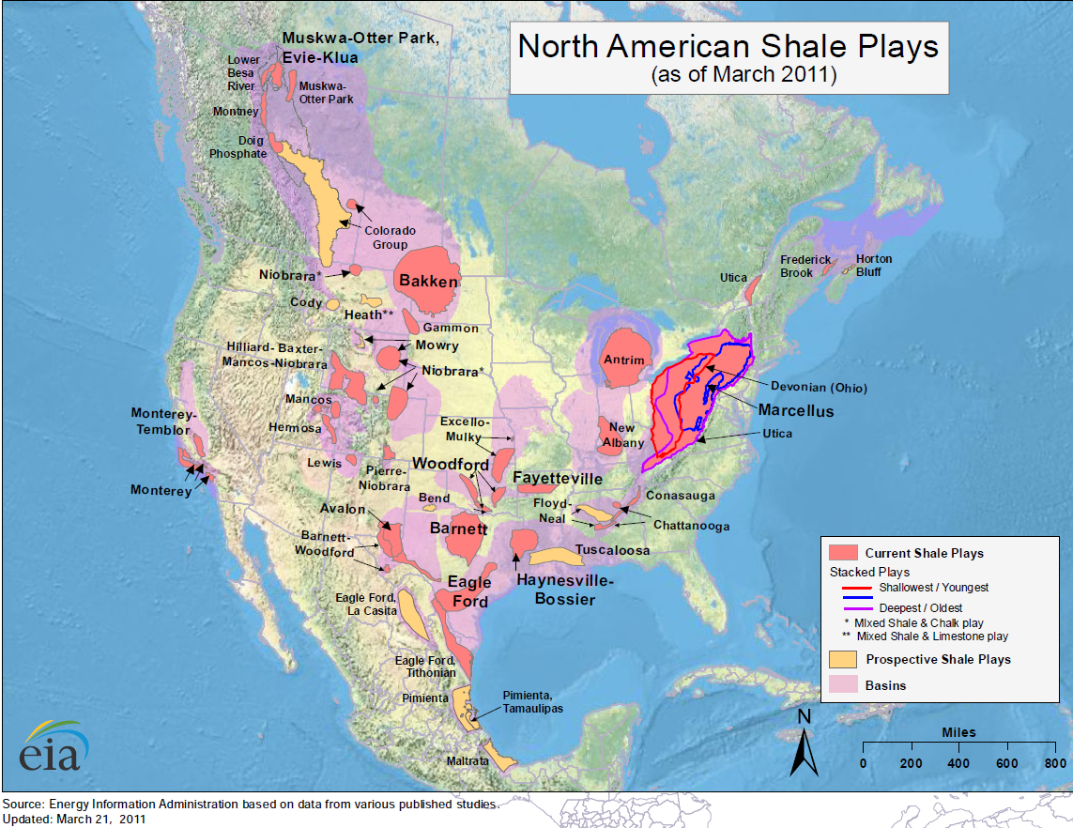

Slide 10
Places for more information
US Energy Information Administration - http://www.eia.gov/
Colorado Oil and Gas Association - http://www.coga.org/
Colorado Oil and Gas Conservation Commission - http://cogcc.state.co.us/
Natural Gas Vehicle Coalition - http://www.ngvc.org/
American Petroleum Institute - http://www.api.org/
FracFocus, hydraulic fracturing fluids - http://fracfocus.org/

Slide 11
Questions

